Slide 1

The Global Tailings Management Institute: timeline and progress
John Howchin
Global Ambassador GTMI
Co-convener of the Investor Mining and Tailings Safety Initiative
Former Secretary General of the Council on Ethics of the Swedish National Pension Funds

Slide 2

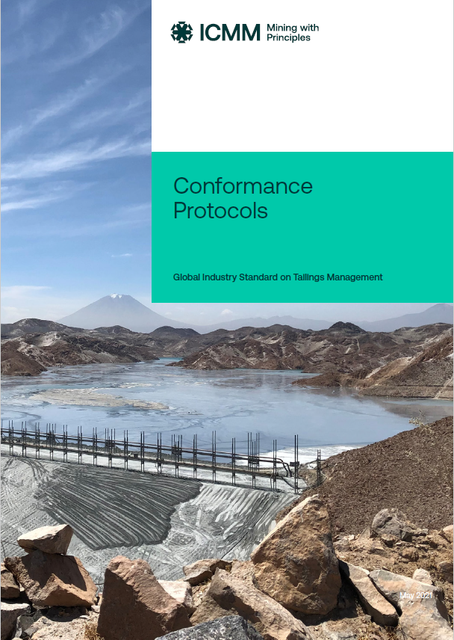
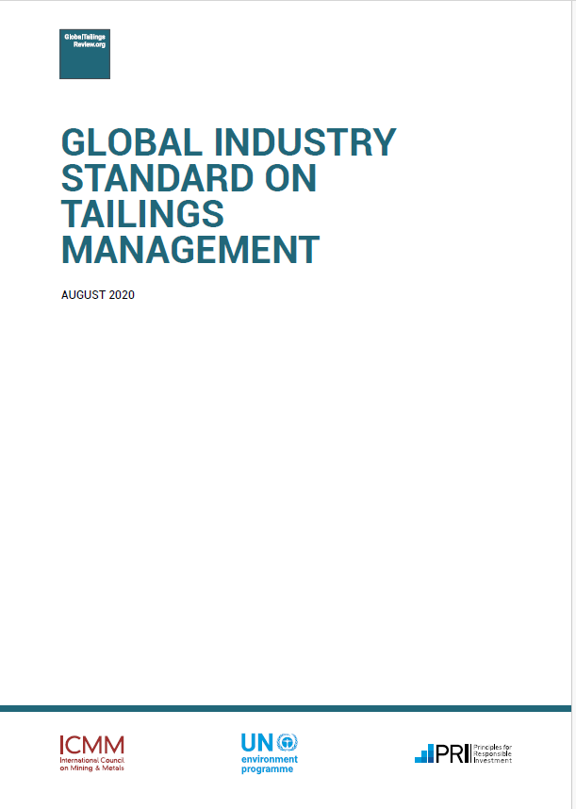

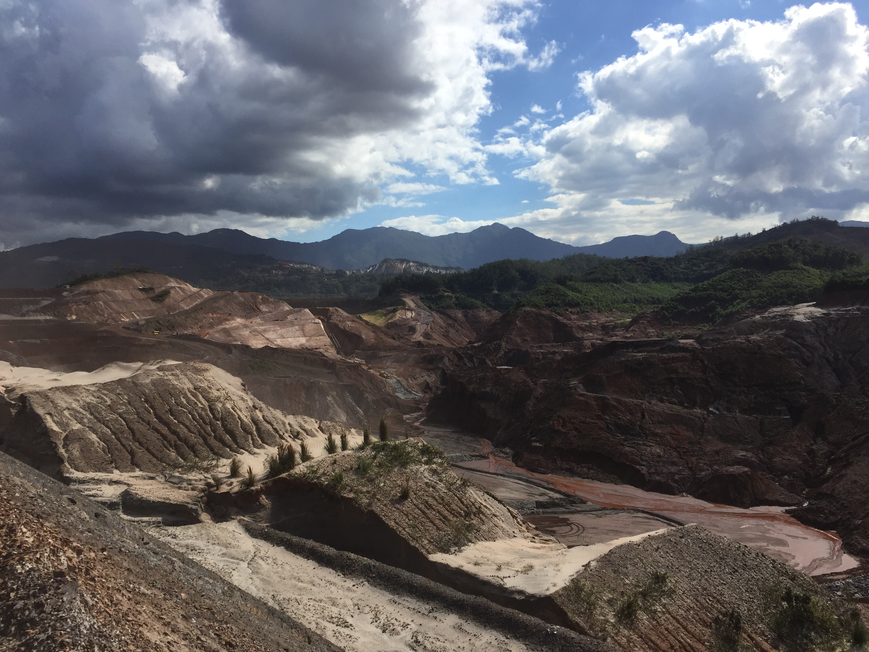
Timeline
Jan: Brumadinho
Feb: ICMM commit to new standard
May: Global Tailings Review
Nov-Dec: public consultation
2023 conformance disclosures
UNEP, PRI announce establishment of an independent global tailings mgmt. institute
Independent advisory panel
2015
2019
2020
2021
2023
2025

Slide 3
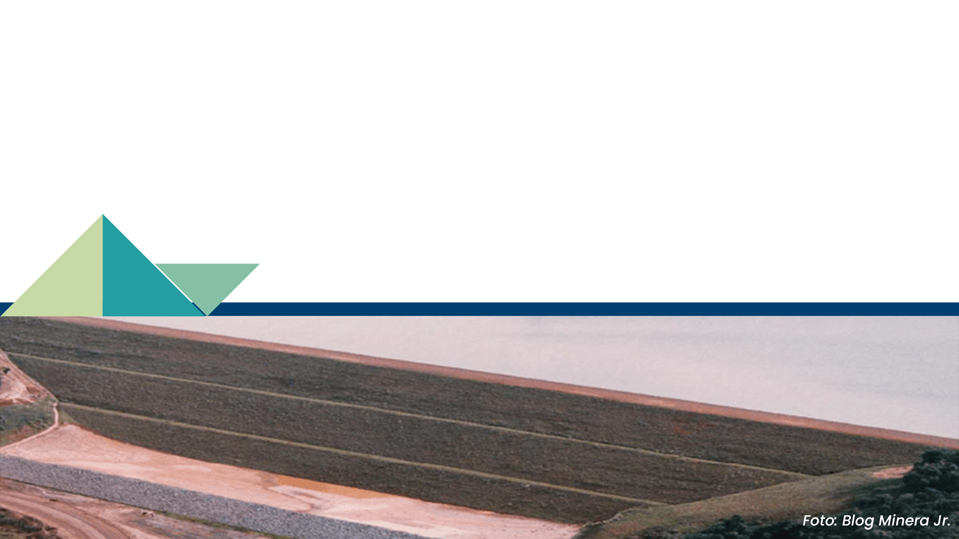
GTMI Overview
Co-founded by PRI, UNEP and ICMM in January 2025
independent, multi-stakeholder governed organisation
incorporated in South Africa
to enhance the safety of mine tailings facilities, across all phases of their lifecycle
to promote widespread adoption and implementation of the Global Industry Standard on Tailings Management
with the goal to achieve zero harm to people and the environment

Slide 4

GTMI Mission
To oversee GISTM implementation and conformance.
● Core function: to manage an assurance framework where tailings facilities will be independently audited and certified against the GISTM by qualified, independent third-party assessors.
●Supported by: raising awareness and encouraging the adoption of GISTM, sharing knowledge and best practices for responsible tailings management, and transparently disclosing auditing outcomes.
GTMI will
Accredit auditors to evaluate and certify tailings facilities.
Review audit reports for completeness.
Publish summary audit reports and corrective action plans on this website.
Provide technical advice on interpretation and implementation of the GISTM

Slide 5
GTMI Governance
Not-for-profit organisation
Governed by a multi-stakeholder board comprising up to 9 members from the following industries and communities:
Mining Industry
Potentially affected communities
Indigenous Peoples
Investment community
Insurance & Banking Industry
Technical and Academic community
Environmental Experts
Workforce
Regulatory Bodies
A Technical Committee will be established to oversee technical matters.

Slide 6
GTMI status update
In-progress: Board establishment
In-progress: CEO recruitment
Next steps: Technical Committee establishment, Chief Technical Officer recruitment
Looking forward: Mining companies become GTMI signatories

Slide 7
GTMI: Becoming a Signatory
Mining companies will become signatories, and commit to responsible tailings management:
Conformance to the GISTM and sharing implementation lessons to inform periodic updates to the Standard
Continuous improvement in tailings management practices
Enhanced communication with stakeholders
Public disclosure and transparency through the GTMI
Social licence to operate
Relationship with regulators and affected communities
Investor confidence
Potential for improved access to preferred insurance coverage

Slide 8
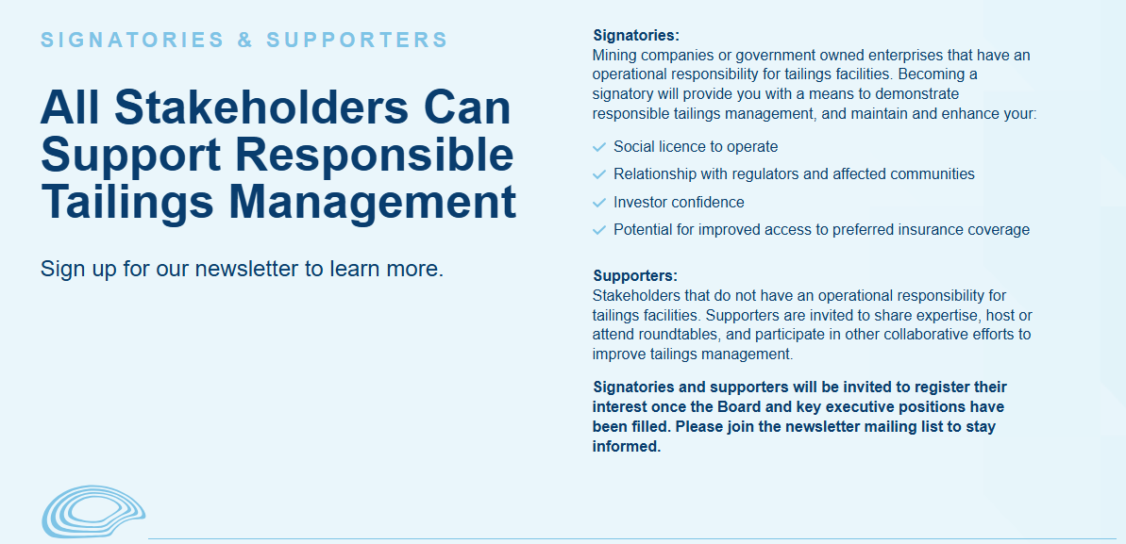
GTMI: Becoming a Signatory

Slide 9





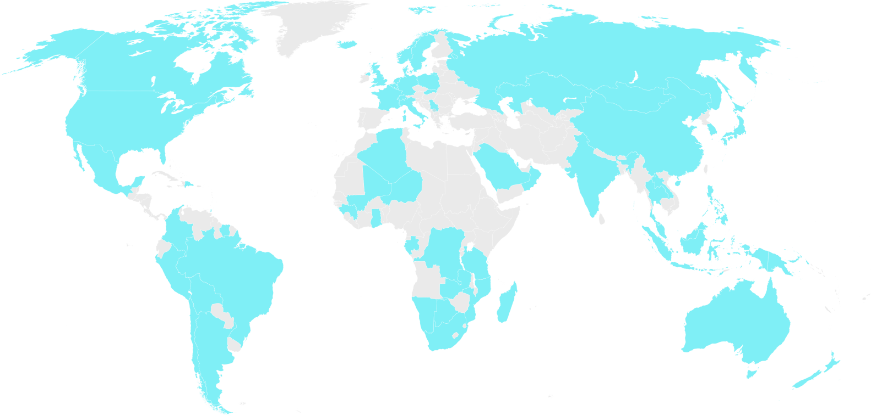










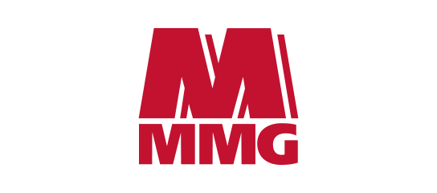



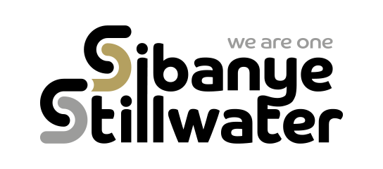




ICMM Members
ICMM brings together a third of the mining and metals sector to drive leadership, action, and innovation. Members set the standard for responsibly produced minerals and metals in a safe, just and sustainable world.

